Slide 1
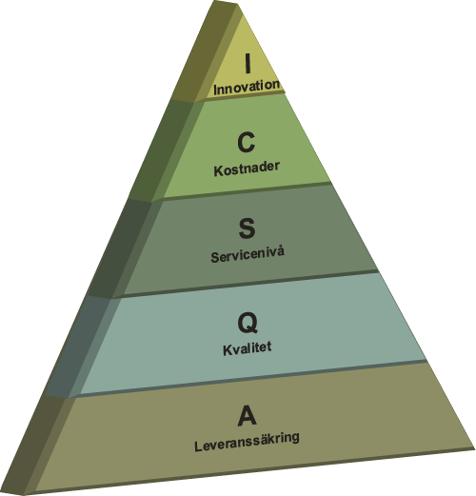
AQSCI-pyramiden
2012-11-24
1
Notes:
1

